Slide 1
Computational and Architectural Design
IN628 Programming 4
Session 2.2
Semester 2, 2016

Slide 2
The Game Cycle
Initialise System
While the game isn’t over
Begin
Check for input
Update game state
Display game state
End
Close
Notes:
Most games programs have the same basic underlying structure
Wait for input, update state, display state
Input is generally user input, although the game state may also change due to game events or triggers. An example is when Sim City residents abandon a building if the crime rate is too high. This happens even if the user doesn’t do anything.
In games programming, this event loop is often called the Game Cycle.

Slide 3
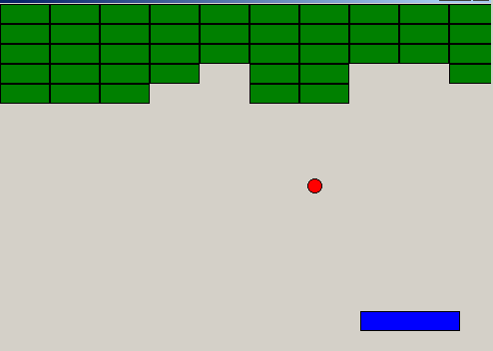
Example: Breakout
Notes:
In this game,the ball moves constantly.
The player uses the arrow keys to move the paddle at the bottom of the screen.
If it hits the paddle it bounces off. If the ball hits a brick at the top, the brick is destroyed, and the ball bounces off.

Slide 4
Game Cycle for Breakout
Check for user input
Update position of paddle (user input)
Update position of ball (continuous motion)
Check for collision between paddle and ball and update state as appropriate
Check for collision between ball and each brick and update state as appropriate
Redraw screen
Notes:
To update the state when ball hits paddle, reverse direction of ball
To update state when ball hits brick, mark brick as crushed in some way. Only draw uncrushed bricks.

Slide 5
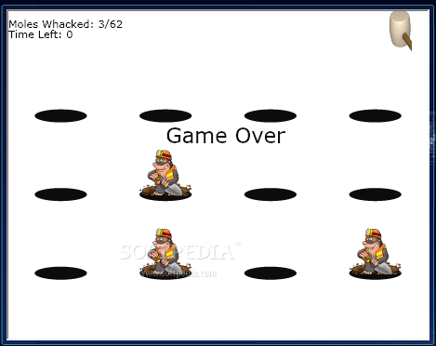
Example: Whack-a-Mole

Slide 6
Game Cycle for Whack-a-Mole
Check for user input
Check for collision between mouse and visible mole
Update mole hit count
Select new random mole and modify its visible
Update screen
Notes:
Assume, for simplicity, that all the moles are all there all the time, we just toggle their visibility

Slide 7
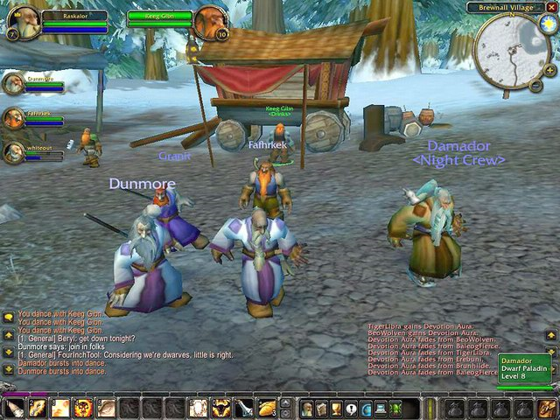
Example: WoW
Notes:
Even the most complex games follow the general game cycle model
The more complex games just have more complex cycles

Slide 8
Game Cycle for WoW
Check for all user inputs
Trigger all events
Update entity states
Update all entity locations
Update 3D geometry
Render display
Notes:
(We will learn more about ‘states’ later. They are an important part of games coding.)
And suddenly you have 100s of thousands of lines of code
And, it’s all sitting on a huge database, and it’s all shipping over the net
But the cycle is the same: check input, update state, update display. Over and over

Slide 9
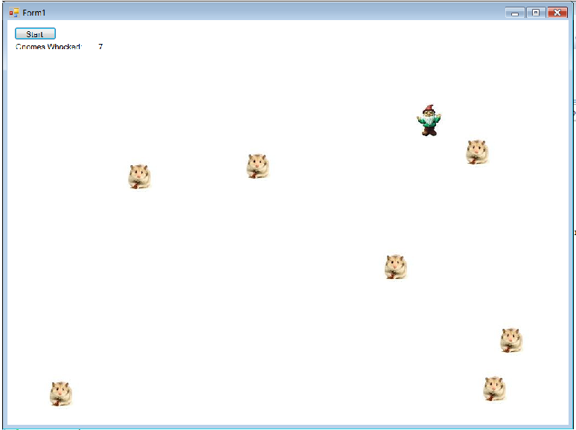
Practical
Whack-A-Gnome
Notes:
A slight variation on whack-a-mole

Slide 10
Whack-A-Gnome – Game Play
Gnomes appear randomly on the screen
One gnome at a time
Gnomes remain briefly on the screen, then disappear
If the user clicks on the gnome, it turns into a hamster
Hamsters remain on the screen
Count of whacked gnomes is maintained
Game ends when all gnomes have been hamsterised.
Notes:
There is a demo on the I: drive

Slide 11
Architecture
Classes:
Something to represent an individual gnome
Something to manage the collection of gnomes
What about handling the display and the user input?
What about running the cycle?
Notes:
The first step in any OO programming task is to think about the classes you need
So Gnome and GnomeFamily. We will discuss
Display and mouse clicks handled by the form class. So everything has a class, we just get the Form one started for us.
For the cycle, we will use a timer, which will be an element of the form class

Slide 12
The Gnome Class
A Gnome needs to know (or have):
A canvas to draw itself to
What image to draw
Its x and y locations
Whether it is a hamster
A Gnome needs to be able to:
Be created
Draw itself
Erase itself
Change its image
Determine if the mouse point is within its boundaries
Notes:
This slide preceded by discussions
Class fields – need to know
NB: We are always working in a 2D space, so an object is completely located by its x and y in the coordinate space of its canvas.
Class methods – need to be able to do

Slide 13
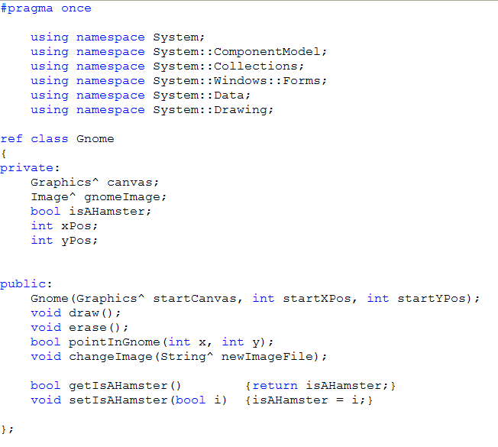
Gnome.h
Notes:
Why do we pass in the canvas? (Not all objects can create a drawable surface, i.e. a Graphics class instance). User-defined classes can’t, so they have to have one created an given to them by a class who can. Fortunately, Forms can.
What will we do with that Image object? (Paint him onto the canvas by calling its DrawImage method.)
Why are there no arguments to draw or erase? (We will draw and erase each gnome at its own xPos,yPos).
How will you write the pointInGnome method? (Simple rectangular collision detection style computation).
What do you think the constructor looks like? (Assign all those arguments to their fields, and set the remainders to sensible defaults)
note that Strings must be managed pointers; no option

Slide 14
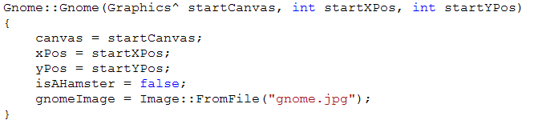
Gnome Constructor
Notes:
Here it is
Remember that the purpose of a constructor is to provide sensible starting values for every class data property.
Note how we don’t need to pass in a starting value for isAHamster or gnomeImage?
Note how we initialise the image? See any problems with this? (All gnomes must look alike.) How might we modify our architecture if we wanted to use different pictures for different gnomes? (Pass in the filename.)
Question: Where does the image file go? If you don’t want to give a full path, you must know what the system uses for its default path. This is different for C# and C++. In C++/CLI, the relative path during complication is where the .h and .cpp files are, not where the executable is generated.

Slide 15
GnomeFamily
A GnomeFamily needs to know (or have):
How many Gnomes it holds
A data structure to hold its collection of Gnomes
A random number generator
A canvas to give its Gnomes at creation
A GnomeFamily needs to be able to:
Be created
Create its Gnomes
Draw and erase its Gnomes (both all and singly)
Check if a particular Gnome has been clicked on
Change its Gnomes’ images
Change its Gnomes’ hamster states
Etc.
Notes:
Precede with discussion
What shall we use to hold that collection?
You will see that the GnomeFamily methods are really just the Gnome methods being called on the elements of the collection.
For example, to draw all the gnomes, you loop through the collection telling each Gnome to draw itself. To draw a single gnome, you index into the collection and tell that gnome to draw itself.
This is a very common architecture: A fairly complex class, and a manager class that holds a collection of the first class and exercises its methods.
Note these patterns. Much of OO programming is knowing the right pattern to use.

Slide 16
Managed Arrays
Managed arrays are class instances
You create a pointer (handle) to an array
You allocate space for the array elements
array<int>^ intArray;
intArray = gcnew array<int>(5);
Notes:
You remember when we said that int intArray[] was old school
Now we want to declare a managed array
This syntax is odd, but it is an example of a large group of .NET classes that can accept their data types at runtime, which is very powerful.
You will see more of this in OOSD, A&DS and Web 3
After you have done this, intArray is used like a regular array
“intArray is a pointer to an array of int”
“Allocate enough space for an array of 5 int, and point intArray at it (i.e. Set intArray’s value to the start of that memory).

Slide 17
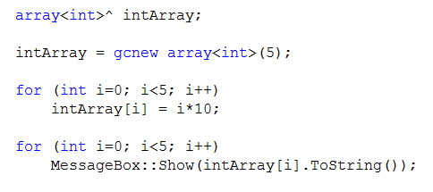
Managed Arrays
Notes:
This code is in a button click handler.
What does it do?

Slide 18
Managed Arrays
What if you want an array of complex objects?
Since complex objects are worked with via pointers, you will need an array of pointers.
array<String^>^ stringArray;
stringArray = gcnew array<String^>(3);
Notes:
Remember that to use components, strings or user-defined types, we use pointers
So how do we make an array of, say String?
The same pattern will work for an array of Gnomes.

Slide 19
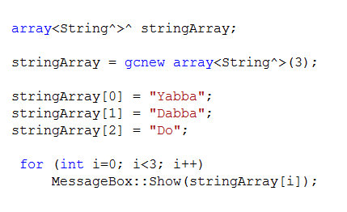
Managed Arrays
Notes:
What will this code do?
Note that strings are special in that we can create them without a new call. We just type something with “” around it.
For user-defined objects, or system objects like buttons, we will need to gcnew to give the pointers in the array something to point at.

Slide 20
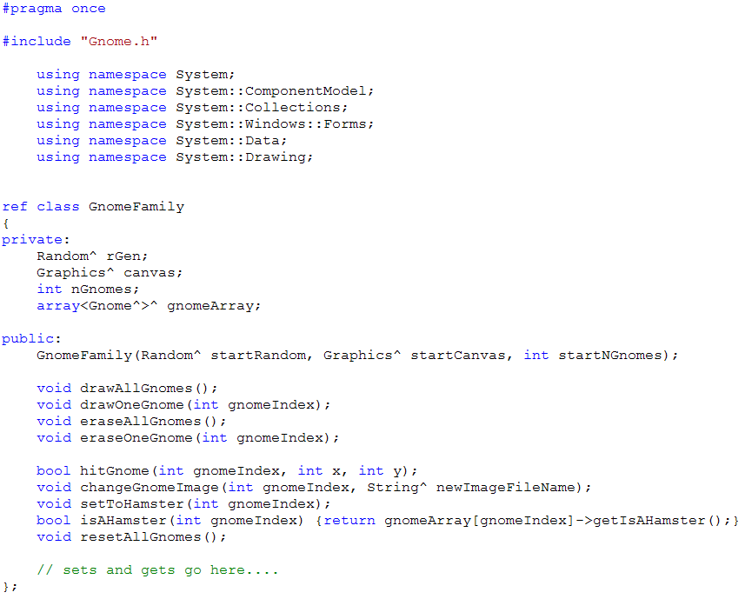
GnomeFamily.h
Notes:
Keeping that in mind, let’s look at the definition of GnomeFamily, which is going to use an array of gnomes.
Walk through
Note the include
Discuss constructor arguments and the common “pass down from the top” pattern
Review in-line declarations
What do we think the constructor will be?

Slide 21
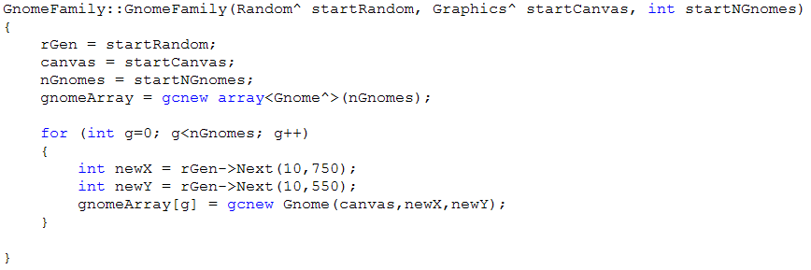
GnomeFamily Constructor
Notes:
Discuss first
NB: Those integer literals are BAD.
Very soon, we will see how to get rid of them
Here is that “making sure you have memory when dealing with arrays of pointers” part.
Note VERY VERY CAREFULLY the two steps required to get yourself an array of Gnomes.
First create an array of gnome pointers
Second, create an individual gnome for each pointer to point to.
The statement that creates the array DOES NOT MAKE THE GNOMES
If you try to call some method on gnomeArray[3] without creating a gnome for that pointer to point to, the system crashes. (It goes off to try to call the method sitting at the address pointed to by whatever random binary junk happens to be sitting in the space reserved for the pointer gnomeArray[3]. This doesn’t work.)

Slide 22
Form Data Fields
Random^ rGen;
Graphics^ mainCanvas;
GnomeFamily^ gnomeFamily;
int gnomeIndex;
int hamsterCount;
Notes:
I have these.
Remember where they go?
As class data members, they go where all class data members go: in the form definition, scoped private.
What do you think that “gnomeIndex” is for?
Let’s pseudcode the form methods now...

Slide 23
Form Methods
Form1_Load
Position the form on the screen
Initialise hamsterCount and gnomeIndex
Create rGen, mainCanvas and gnomeFamily
Notes:
Note that we must create gnomeFamily after the other two. Do you know why?

Slide 24
Form Methods
btnStart_Click
Reset all the gnomes
Set the counter label back to zero
Turn the timer on
btnStart_Click
Tell the gnomeFamily to reset all the gnomes
Set the counter label back to zero
Turn the timer on
Notes:
How will we reset all the gnomes? => We will tell the gnomeFamily to do it. The gnomeFamily must expose an appropriate method.
As your architectures get more complicated, it becomes important that each class is doing one job and one job only.
The Form’s job is to listen to the mouse and draw on the screen. It is the gnomeFamily’s job to manage the gnomes.
Don’t slosh jobs together, as it makes your code very hard to maintain.
So it’s more accurate this way...

Slide 25
Form Methods
Form1_MouseDown
Ask the gnomeFamily if the mouse position is contained within the currently displayed gnome.
If so
Tell the gnomeFamily to change the current gnome’s image to hamster
Tell the gnomeFamily to change the current gnome’s hamster state
Increment the hamster count
Notes:
The user is going to click on the form.
This logic happens only when the user clicks.
It updates the state of the game (i.e. which gnomes are hamsters)
It can run quite happily in parallel with the timer, that is constantly updating the display. There is no conflict.
VS manages this asynchronicity for us.
(NB: Some students may want to decouple the application logic more. That is fine.)

Slide 26

More on MouseDown
Notes:
It’s a little hard to see here, but in the form’s mouseDown event handler, you are passed in the MouseEventArgs object e
It has properties X and Y corresponding to the mouse location.
Since it is a pointer, you use the -> operator to get those values
Do you remember how to get the MouseDown event handler? => See the lightning bolt in the properties window.

Slide 27
Form Methods
timer1_Tick
Erase the current gnome
Display all hamstered gnomes
Select a new gnome to display
Display him
If all the gnomes have been hamstered
Turn off the timer
Show the win message
Notes:
And here is the tricky one.
This is the game cycle. We check and update the state, then redisplay.
...
Don’t make it go too fast...
Now you are nearly ready to write your Whack-A-Gnome

Slide 28
Practical Due Monday 9.00 am
Write Whack-A-Gnome
Images are on the I drive, or use your own (legal only).
This is a checkpoint.
Use your GitBucket repo for submission (and source control during development).
Push your finished version by the deadline.
Please use good commit message technique.

